Slide 1
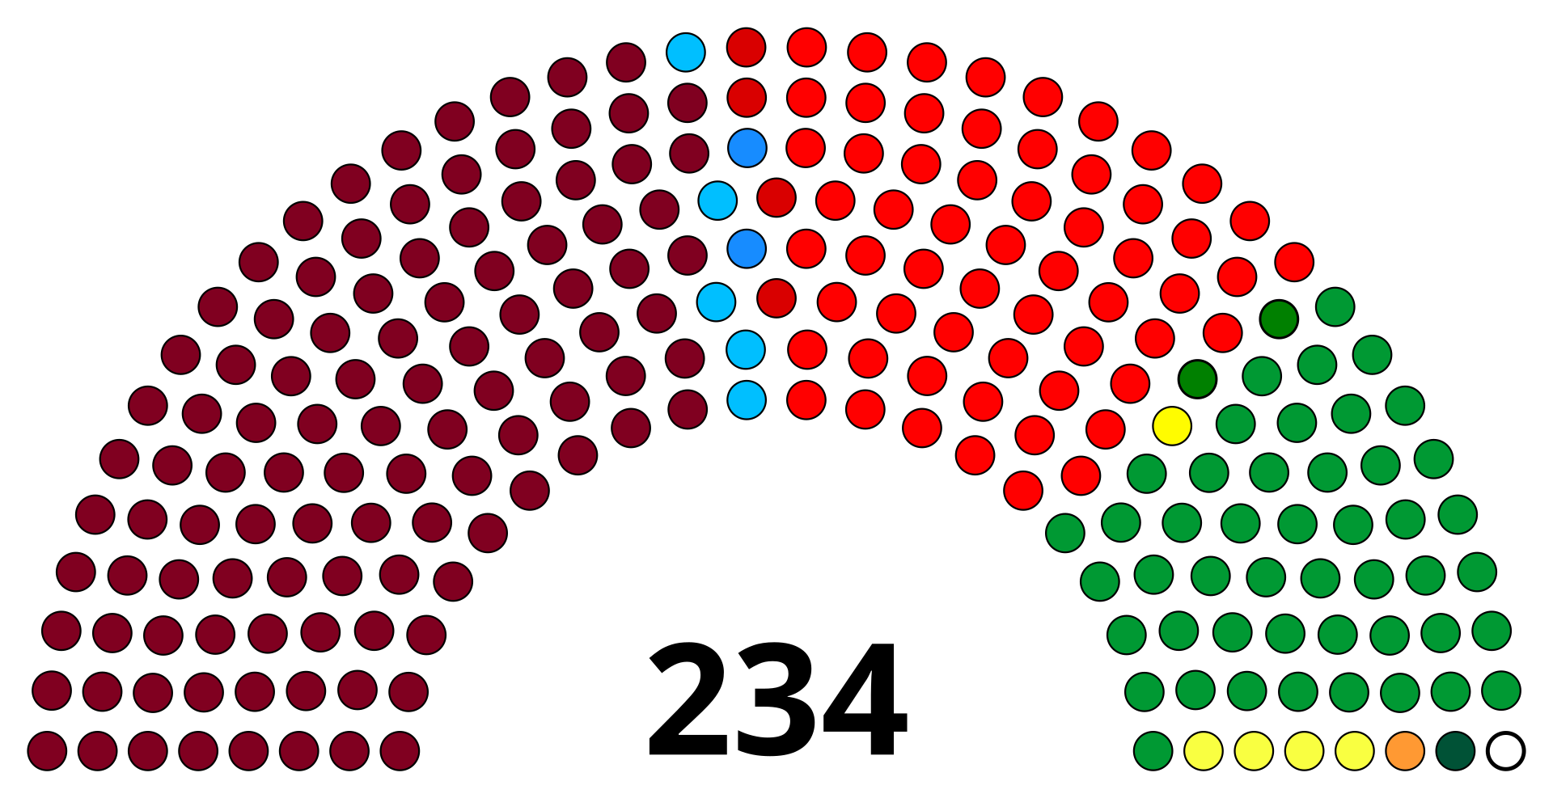
The Number Games: Tamil Nadu Election 2026
Analysed by Md Shafi Alam

Slide 2
What Broke and Where?

Slide 3
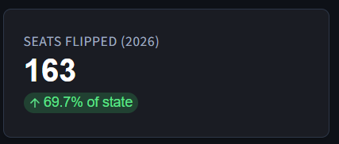
The Flip Story
The Night 163 out of 234 Constituencies Changed Their Mind
The HIGHEST seat turnover in the state's modern political history.

Slide 4
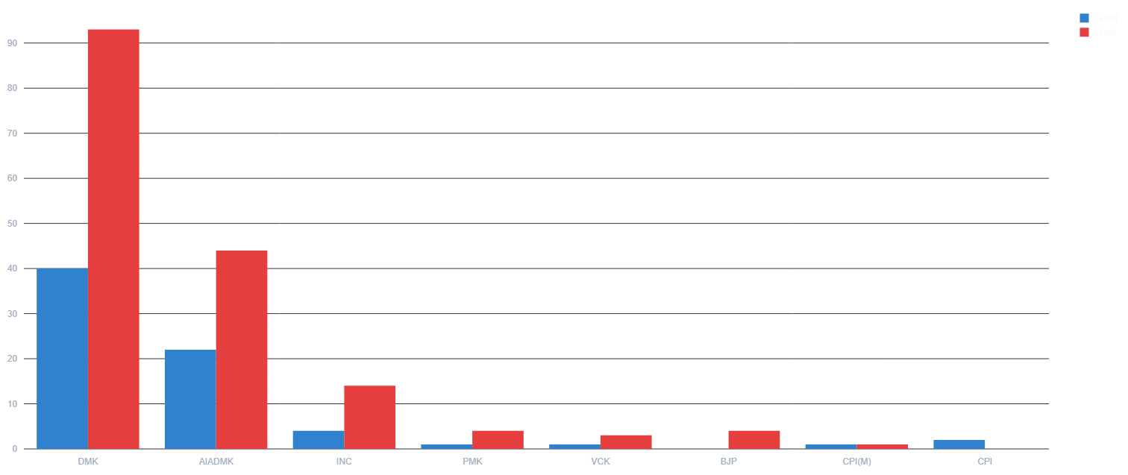
The Flip Story
Tamil Nadu Didn't Have an Election. It Had a Replacement.
Only 71 seats or 3 out of each 10 seats are retained

Slide 5
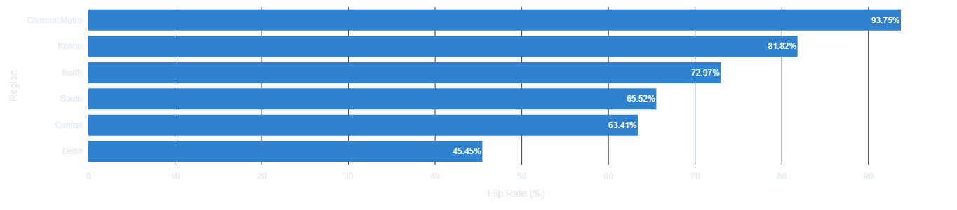
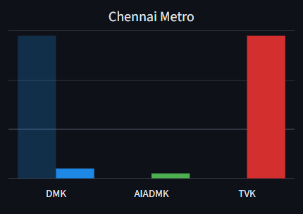
The Flip Story
The Capital Rejected Its Own Government
30 of 32 Chennai Seats Changed Hands which is nearly 93.75%

Slide 6
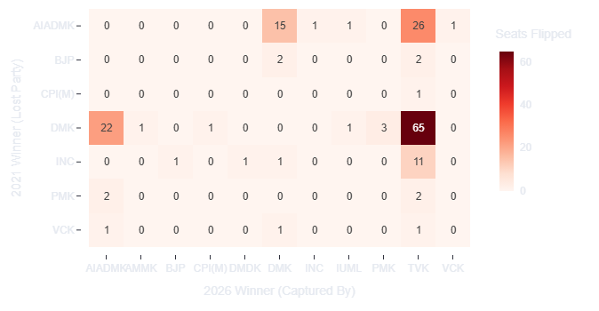
The Flip Story
TVK, The Great Absorber
TVK captured 2 out of every 3 flipped seats which is nearly 66.3% of flipped seats

Slide 7
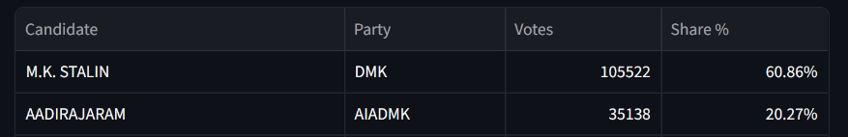
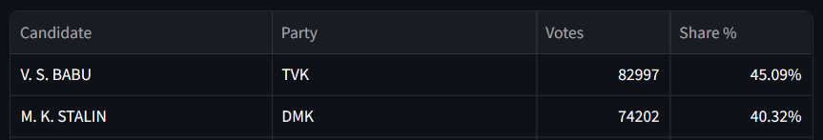
The Flip Story
The Chief Minister's own constituency. Kolathur. Gone to TVK
2021
From winning in 70,384 votes
2026
To loosing in 8,795 votes

Slide 8
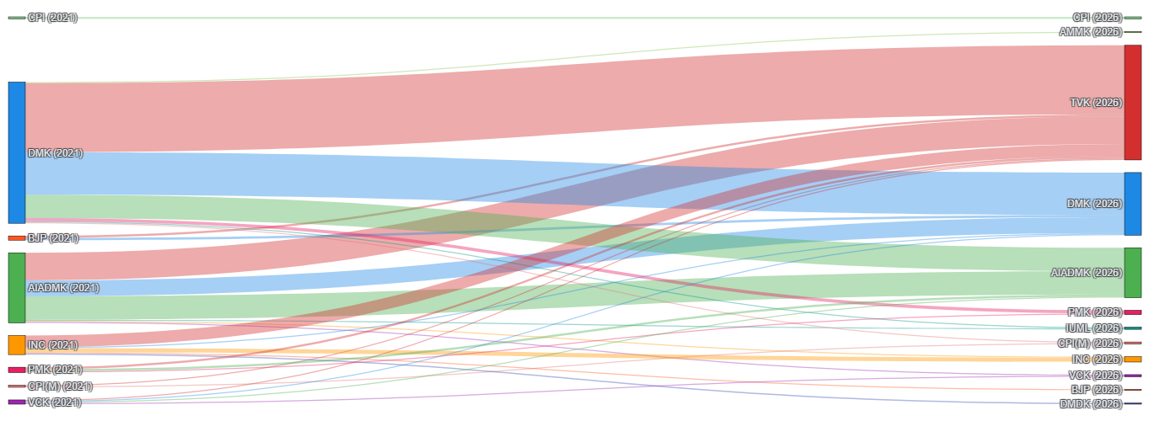
The Flip Story
The Great Flips and Flows
Most of the parties contributed seats to TVK

Slide 9
Could a new party really rise this fast?

Slide 10
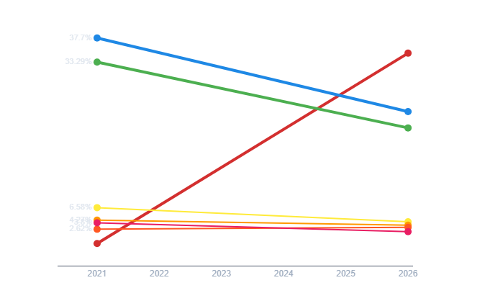
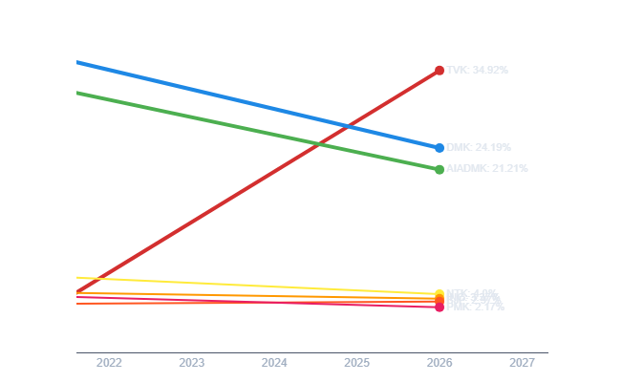
The Vote Share Story
Meteoric Rise of an Unseen Party
From 0 in 2021 to a staggering 34.92% vote share
That’s 1,72,26,209 raw votes

Slide 11
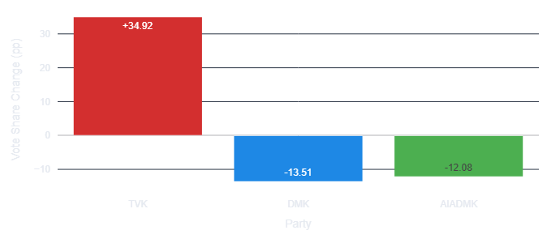
The Vote Share Story
The Maths of Who Paid For This, Is Not Subtle
Dravidian party’s haemorrhage of 25.59 PP explains most of TVK’s gain

Slide 12
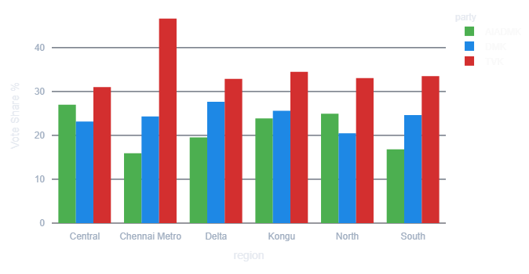
The Vote Share Story
Not One, Not Once, A Tidal Wave of Same Depth
46.63
32.87
34.49
33.06
33.52
31.02
Floor 31.0% in Central, ceiling 46.6% in Chennai, leaves oppositions no room

Slide 13
The Vote Share Story
In Chennai Metro, Nearly 1 in 2 Voters Choose a Party That Didn’t Exist Last Time
2021
2026
Vote Share – 45.34%
Vote Share – 46.63%
DMK got 29.7 lakhs votes out of 65.6 lakhs vote
TVK got 33 lakhs votes out of 70.7 lakh total votes

Slide 14
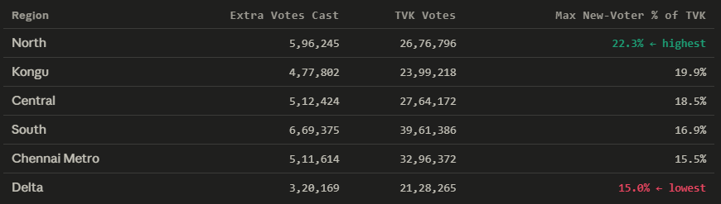
The Vote Share Story
The Wave is A Migration, Not An Arrival
New voter contribution could be maximum 15-22% of total votes
Other 80-90% votes comes from switchers

Slide 15
So how competitive did the battleground become?

Slide 16
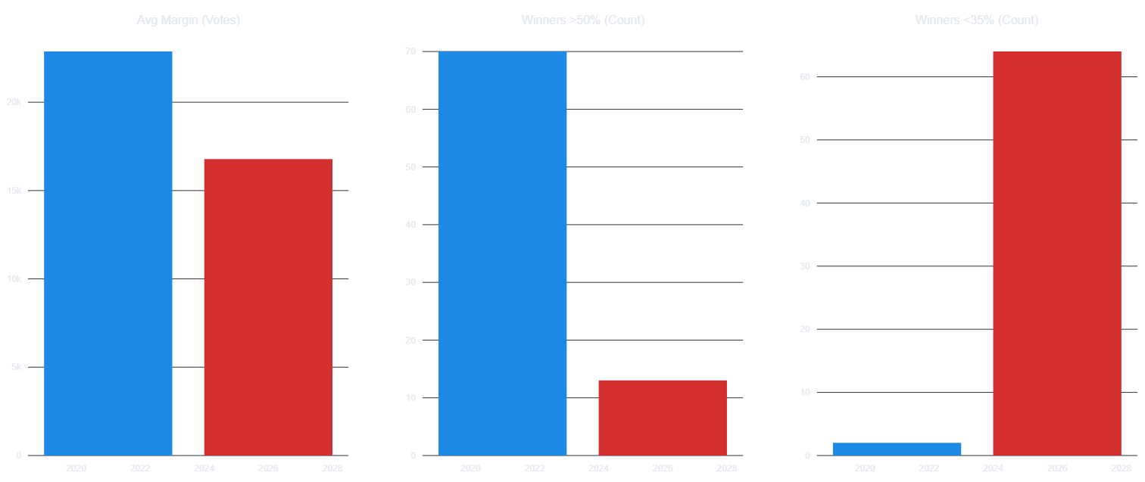
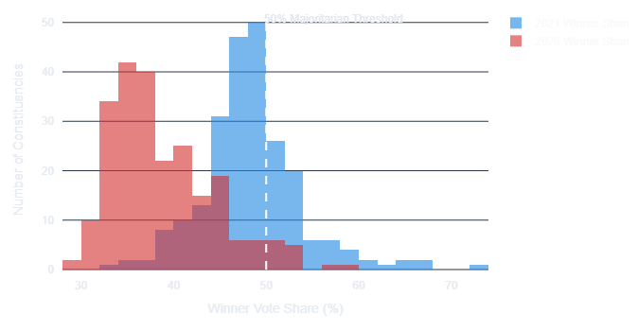
The Margin of Victory Story
The Great Tripolar Effect
2021
2026
2026 winner vote share gets shallower. From 22.9k to 16.8k

Slide 17
The Margin of Victory Story
An 81% Collapse in Clear Mandates
2021
Winners with >50% vote shares reduced from 70 to 13
2026

Slide 18
The Margin of Victory Story
64 Elected MLAs Cannot Claim a Majority
2021
2 to 64, a massive 32x shoot for <35 vote share winners
2026

Slide 19
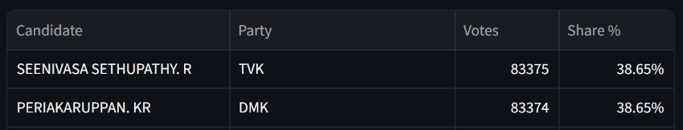
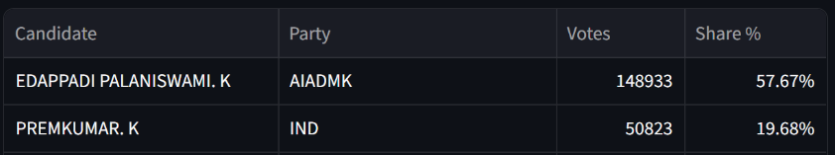
The Margin of Victory Story
1 Vote Margin Vs 1 Lakh Vote Margin
In Tirupattur (AC-185) 1 vote decides winner
In Edappadi nearly 1 lakh margin created landslide victory

Slide 20
Editorial Recommendation
The show should retain the deck’s carefully designed three-act storytelling structure, where every segment builds toward its own climax while contributing to a larger narrative arc.
Each slide should answer the previous question while creating curiosity for the next, ensuring continuous viewer engagement.
Since the programme is heavily data-driven, the focus should remain on concise, interconnected insights rather than overwhelming audiences with excessive statistics. The goal is to make the analysis informative, engaging, and highly watchable for a broad audience.

Slide 21
Data Limitations
The analysis is conducted on the publicly available constituency level data.
Any demographic, caste, income or survey based data is not incorporated in this analysis
Coalition negotiation, campaign spending, candidate influence were outside the scope of the analysis

Slide 22
Thank You.

Slide 23
Disclaimer
This presentation is intended purely as a data-oriented analytical exercise and storytelling framework based on publicly available election data, trends, and statistical interpretations. The objective is neither to support nor criticize any political party, ideology, leader, or voter group. All insights, comparisons, and visualizations are presented solely for informational, educational, and analytical purposes. Interpretations may evolve with new data, and viewers are encouraged to form their own independent opinions and conclusions

